Slide 1
Big Mountain Resort Data Analysis
Chris Dickerman

Slide 2
Table of Contents
Problem identification
Recommendation and key findings
Modeling results and analysis
Summary and conclusion

Slide 3
Problem Identification
Is Big Mountain pricing their tickets correctly?
What changes can be made to increase ticket price?

Slide 4
Recommendations and Key Findings
Is Big Mountain pricing their tickets correctly?
Actual Price: $81 USD
Modeled Price: $95.87 USD [mean error 10.39]

Slide 5
Modeling Results and Analysis
What changes can be made to increase ticket price?
Adding a new run, increasing the vertical drop by 150 feet, and installing an additional chair lift.
Ticket price increase: $2.99 USD
Expected revenue increase: $3,474,638 USD

Slide 6
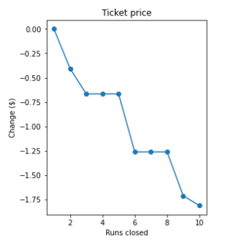
Modeling Results and Analysis
Closing a single run does not reduce ticket price

Slide 7
Summary and Conclusion
Add a new run, increase the vertical drop by 150 feet, and install an additional chair lift
Close the least popular current run
Trial new ticket price of $95 USD

